Slide 1
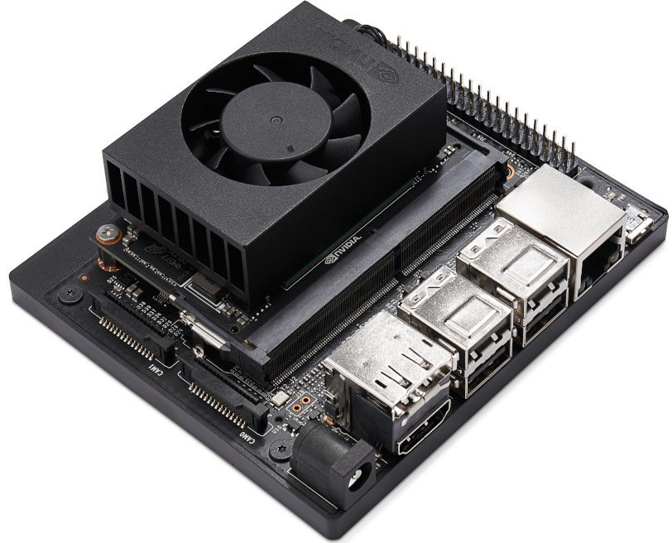





DEVELOPING DRIVER ASSISTIVE SYSTEM USING
NVIDIA JETSON DEVELOPMENT BOARD
PRINCIPAL SUPERVISOR - Prof. K. AHILAN
ASSOCIATE SUPERVISOR – ENG. R. VALLUWAN
GROUP MEMBERS:
HERATH H.P.H.N. – 2018/E/042
RATHNAYAKE R.M.S.U. – 2019/E/110
Notes:
1

Slide 2



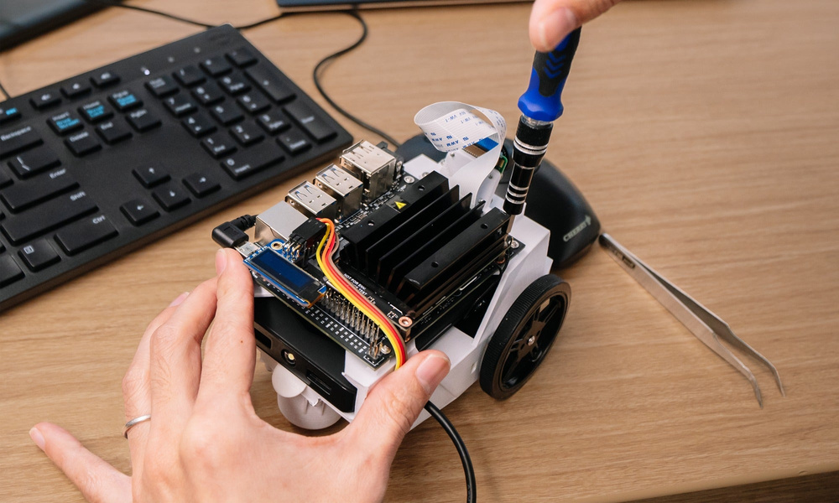

CONTENT
INTRODUCTION
PROBLEM STATEMENT
OBJECTIVES
SCOPE
RESEARCH GAP
PROGRESS
METHODOLOGY
CHALLENGES & SOLUTIONS
TIMELINE
DEVELOPING DRIVER ASSISTIVE TECHNOLOGY USING NVIDIA JETSON DEVELOPMENT BOARD 02

Slide 3

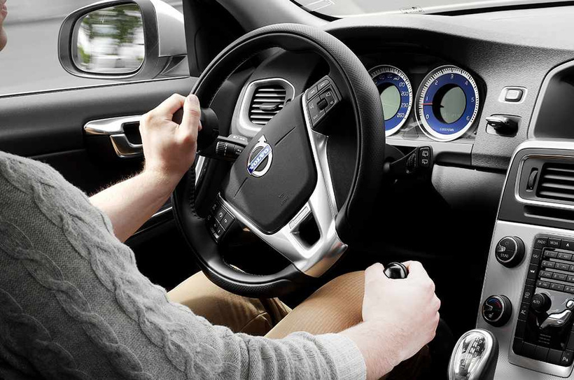


INTRODUCTION
WHAT DO YOU MEAN BY DRIVE ASSISTIVE TECHNOLOGY?
Drive assistive technology refers to advanced systems and features designed to support and enhance the driving experience by aiming improving safety, convenience, and comfort for drivers and passengers.
FEATURES:
Lane Departure Warning and Lane Keeping Assist
Traffic Sign Recognition
Driver Monitoring Systems
Gesture Control
By incorporating NVIDIA Jetson development board and machine learning based embedded system we want to modify the system by filling the gaps in exist driver assistive technologies.
DEVELOPING DRIVER ASSISTIVE TECHNOLOGY USING NVIDIA JETSON DEVELOPMENT BOARD 03

Slide 4



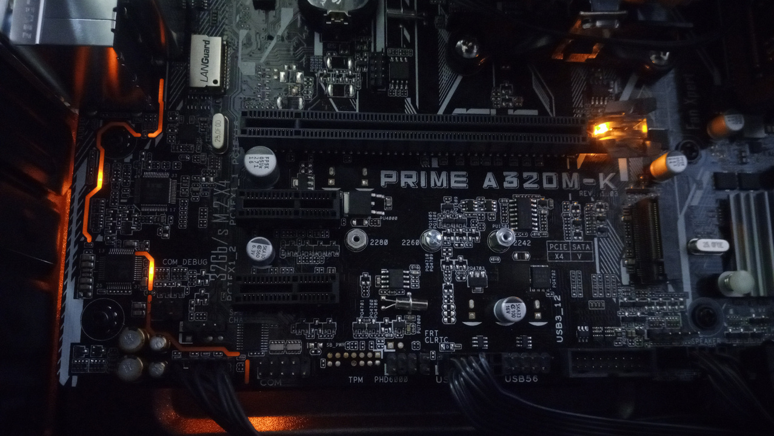


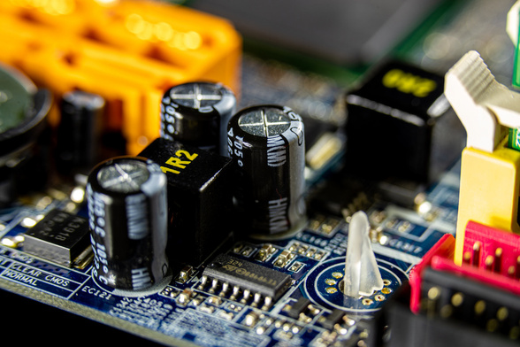

OBJECTIVES
To monitor a vehicle’s surroundings and make driving tasks easier and safer.
Automatically switches on your car’s high-beams in appropriate low-light situations and shuts them off when it detects headlights or taillights
Forward-collision warning
Speed-limit assist
DEVELOPING DRIVER ASSISTIVE TECHNOLOGY USING NVIDIA JETSON DEVELOPMENT BOARD 04

Slide 5
RESEARCH GAPS
Modern vehicles integrate drive assistive systems like speed limit assist, forward collision warning, and adaptive headlight adjustments.
However, legacy vehicles lack these integrated systems, highlighting the need for advanced drive assistive technology.
Our project aims to bridge this gap by developing drive assistive technology using the NVIDIA Jetson development board.
DEVELOPING DRIVER ASSISTIVE TECHNOLOGY USING NVIDIA JETSON DEVELOPMENT BOARD 05

Slide 6

PROGRESS
DEVELOPING DRIVER ASSISTIVE TECHNOLOGY USING NVIDIA JETSON DEVELOPMENT BOARD 06

Slide 7

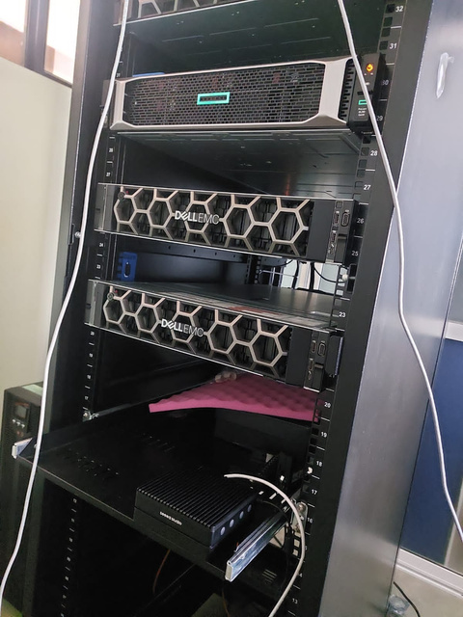


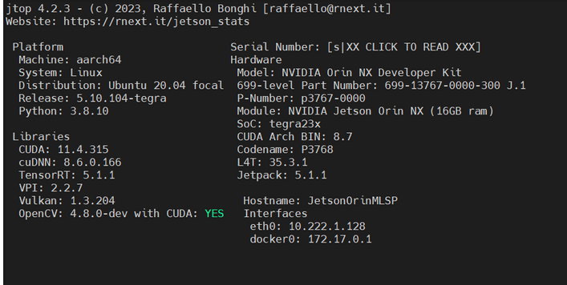
WHAT WE DID SO FAR?
FAMILIARIZING WITH NVIDIA JESTON DEVELOPMENT BOARD
One popular product in the Jetson family
Jetson modules are based on NVIDIA's CUDA architecture.
Power mode 25W.
NVIDIA provides a comprehensive software stack for Jetson modules
CUDA Toolkit – 11.4.315
JetPack – 5.1.1
Simple we can get these details by commanding as jtop on jetson node.
DEVELOPING DRIVER ASSISTIVE TECHNOLOGY USING NVIDIA JETSON DEVELOPMENT BOARD 07
Notes:
CUDA – COMPUTE UNIFIED DEVICE ARCHITECTURE
ITA S PARALLEL COMPUTING PLATFORM AND PROGRAMMING MODEL FOR GPU. IT ALLOW FOR GENERAL PURPOSE USES.
7

Slide 8
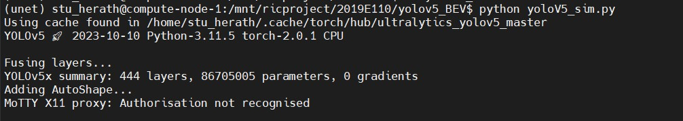
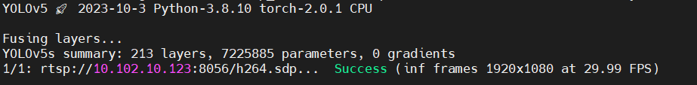
2. TRAINING THE MODEL USING THE AVAILABLE DATASET
Two programs were used.
yoloV5
yoloV5_BEV
Dataset used
COCO DATA SET
(80 object categories)
Why we trained these models?
For object detection.
Yolov5s and yolo5x PyTorch model files were used.
the YOLOv5x model is larger and more powerful than the YOLOv5s model. It has a higher accuracy
DEVELOPING DRIVER ASSISTIVE TECHNOLOGY USING NVIDIA JETSON DEVELOPMENT BOARD 08
Notes:
8

Slide 9
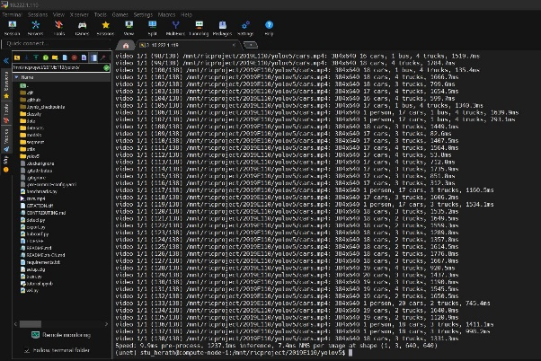
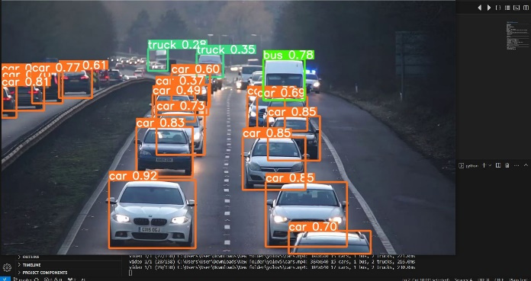
Initially yolov5 was used to detect the object.
Before deploying the to the jetson card this was done using server terminal.
We used a video (mp4) as a input source and according to that video object detection was done.
It showed the inference frame with the time.
DEVELOPING DRIVER ASSISTIVE TECHNOLOGY USING NVIDIA JETSON DEVELOPMENT BOARD 09

Slide 10
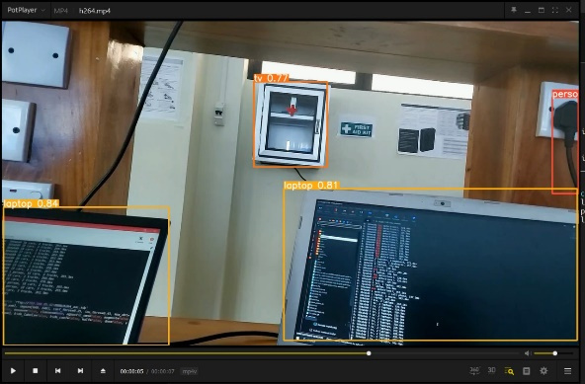
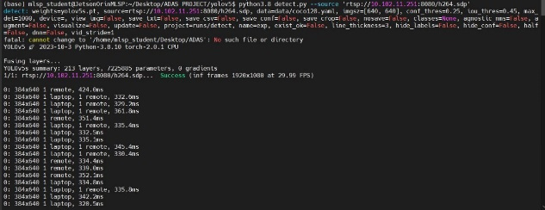
3. DEPLOYING THE MODELS IN NVIDIA JETSON DEVELOPMENT BOARD
We deployed same yolov5 model in jetson orin card. It was successfully deployed.
Then we changed the input source to camera input.
We used live RTSP camera stream using a mobile phone camera as the source though a mobile app called ‘IP Webcam’.
DEVELOPING DRIVER ASSISTIVE TECHNOLOGY USING NVIDIA JETSON DEVELOPMENT BOARD 10
Notes:
10

Slide 11
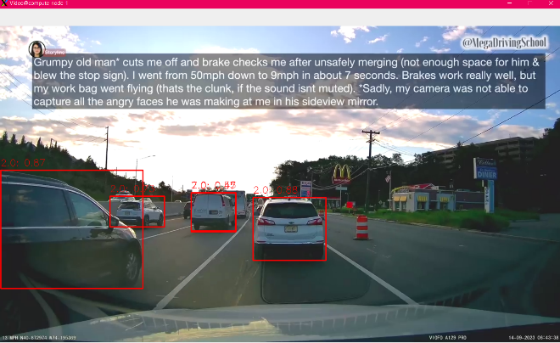
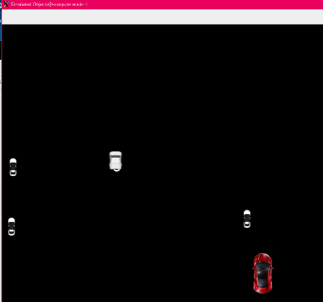
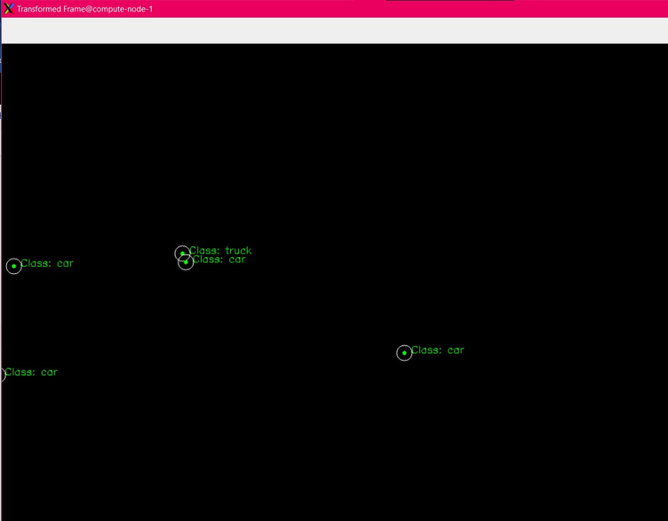
4.GENERATING MAPS
After the yoloV5 we move into yoloV5 BEV model
We were able to generate birds eye view of the driving environment in addition to the object detection done by the yolov5 mode.
Three maps were generated. Using those maps we can walk to achieve the pre mentioned objectives.
DEVELOPING DRIVER ASSISTIVE TECHNOLOGY USING NVIDIA JETSON DEVELOPMENT BOARD 11
Notes:
11

Slide 12
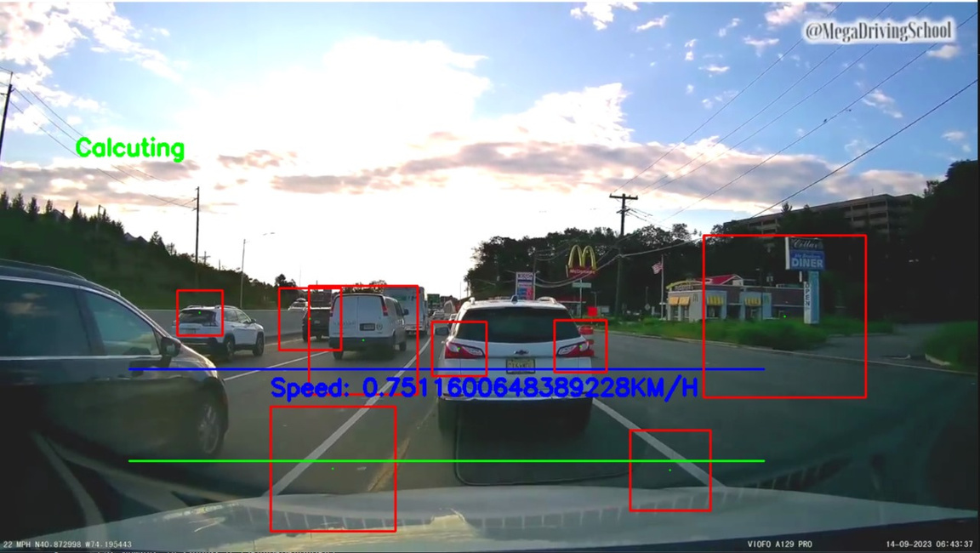
5. SPEED LIMIT ASSIST
Now we are on the stage of speed limit assist. In here we have trained our model to recognize speed signs on the road.
it will display on the GUI of the system.
Then with the comparison, we are going to give alert to the drive if it exceed the speed of speed sign.
DEVELOPING DRIVER ASSISTIVE TECHNOLOGY USING NVIDIA JETSON DEVELOPMENT BOARD 12

Slide 13
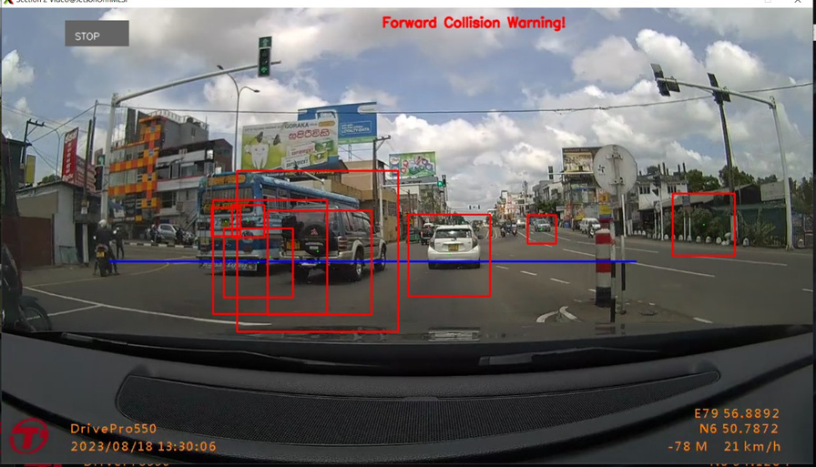
6. Forward collision warning & Automatic headlight control
Objects in front of the vehicle were identified.
The distance to each object was estimated using computer vision techniques.
The time to impact for each object was calculated by dividing the distance to the object by the vehicle's relative speed. If the time to impact for any object was found to be less than a certain threshold, an alert could be provided to the driver.
DEVELOPING DRIVER ASSISTIVE TECHNOLOGY USING NVIDIA JETSON DEVELOPMENT BOARD 13
Notes:
13

Slide 14
6. Getting the Values for Performance Analysis
Performance Analysis Metrics
Metric | Description | Speed Limit Detection & Assist | Forward Collision Warning | Headlight Control
Accuracy | Proportion of correct predictions | >= 95% | >= 90% | >= 95%
Precision | Ratio of true positives to all positive predictions | >= 90% | >= 90% | -
Recall | Ratio of true positives to all actual positives | >= 90% | >= 90% | -
False Positive Rate (FPR) | Rate of incorrect predictions | <= 5% | <= 10% | -
Warning Latency | Time from detection to alert | <=0.5 seconds | <= 0.2 seconds | <= 0.3 seconds
DEVELOPING DRIVER ASSISTIVE TECHNOLOGY USING NVIDIA JETSON DEVELOPMENT BOARD 13
Notes:
13

Slide 15
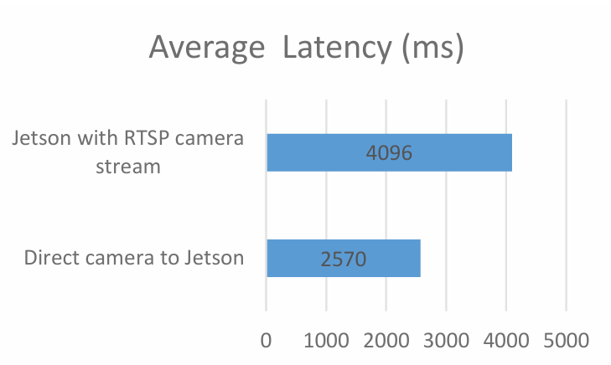
6. Getting the Values for Performance Analysis
Latency
latency = frame rate * latency per frame
frame rate=30fps
latency per frame =0.1537s
latency per frame =0.1528s
latency per frame =0.1536s
latency per frame=0.1520s
4096
2570
DEVELOPING DRIVER ASSISTIVE TECHNOLOGY USING NVIDIA JETSON DEVELOPMENT BOARD 13
Notes:
13

Slide 16









BUSINESS CANVAS
Key Partners
Key Activities
Value propositions
Customer Segments
Customer Relationships
Product Development
Build and maintain relationships
Provide expert installation services, user training, and ongoing after-sales support
NVIDIA
Sensor and Camera Manufacturers
Automotive Manufacturers
Software Development Firms
Regulatory Agencies
Automotive Manufacture
Insurance companies
Car sales
R & D Institutes
Government and Regulatory Bodies
Enhances safety by reducing the risk of accidents through real-time driver assistance.
improves driver comfort by assisting with challenging tasks such as highway driving.
Supports drivers in meeting legal requirements for safety features in vehicles.
We will build long-term partnerships with automotive manufacturers and fleet operators.
Our customer support will provide installation, training, and after-sales service.
We will engage with users through online communities and feedback channels.
Channels
Key Resources
Direct Sales
Exhibitions & Trade Shows
Social Media & Digital Marketing
Advanced Hardware Components.
Cost Structure
Revenue Streams
Research and Development (R&D) costs
Hardware and sensor components
Software development and licensing
Marketing and sales expenses
Regulatory compliance and certification
Customer support and training
Money from selling hardware units
Fees from licensing the technology to car companies
Subscription fees for software updates and extra features
Revenue from selling anonymized data
Income from installation and maintenance services
DEVELOPING DRIVER ASSISTIVE TECHNOLOGY USING NVIDIA JETSON DEVELOPMENT BOARD 15

Slide 17
INNOVATIVE SOLUTIONS
The system is going to introduced for the existing vehicles.
Personalized Driver Assistance and Comfort
User-configurable ADAS features
Context-aware assistance
Integration with existing in-vehicle systems
And also finally we are going to connect all these things through mobile app. So, driver can get all these facilities through the mobile app.
DEVELOPING DRIVER ASSISTIVE TECHNOLOGY USING NVIDIA JETSON DEVELOPMENT BOARD 15

Slide 18
CHALLENGES AND SOLUTIONS
CHALLENGES | SOLUTION
we got some errors while creating the required environment in jetson card. Ex: installed torch and torch vision version were not compatible | We had to remove all the installed versions and had to upgraded all to new versions Ex: jetpack version 5.1.1. Compatible torch version: 2.0.1. Compatible torch vision version: 0.15.2 Compatible open cv version : 4.5.4
We need USB or CSI camera as an input in order to deploy the model. | We use live RTSP camera stream using a mobile phone camera as the source though a mobile app called IP Webcam.
Environmental Variations - Weather conditions, lighting changes, and complex road scenarios can affect sensor performance and algorithm accuracy. | Train algorithms on diverse datasets covering a wide range of weather and lighting conditions. Implement adaptive algorithms that adjust processing based on real-time environmental factors.
Getting real time speed to inside of the vehicle | We are going to develop mobile app therefore we can get the speed from the mobile app and it can be connected to the Jetson card through API.
DEVELOPING DRIVER ASSISTIVE TECHNOLOGY USING NVIDIA JETSON DEVELOPMENT BOARD 20
Notes:
20

Slide 19
CHALLENGES AND SOLUTIONS
CHALLENGES | SOLUTION
Real-time Processing Requirements Driver assistance systems demand low latency for timely decision-making and warnings. | Optimize algorithms for faster processing on the Jetson. Utilize efficient data structures and memory management techniques. Prioritize tasks critical for immediate driving decisions.
Limited Computing Power Jetson boards have processing limitations compared to powerful desktop GPUs. | Optimize algorithms for real-time performance on the Jetson. Utilize efficient deep learning models like YOLOv5s or TinyML models. Implement edge computing by offloading complex tasks to cloud resources when necessary.
Sensor Fusion Complexity- Integrating data from diverse sensors like cameras, radar, and LiDAR requires robust algorithms and calibration. | Develop reliable sensor fusion algorithms that account for different sensor characteristics and data formats. Employ calibration techniques to ensure accurate spatial alignment and timing between sensors. Leverage sensor-specific libraries and frameworks like OpenCV for camera data processing.
DEVELOPING DRIVER ASSISTIVE TECHNOLOGY USING NVIDIA JETSON DEVELOPMENT BOARD 20
Notes:
21

Slide 20

THANK
YOU!
DEVELOPING DRIVER ASSISTIVE TECHNOLOGY USING NVIDIA JETSON DEVELOPMENT BOARD 22

